Slide 1
LIGHTWEIGHT NETWORK IDS USING MACHINE LEARNING FOR CYBERATTACK CLASSIFICATION
Sander Soares – 2022164
Thiago Gonçalves - 2022161

Slide 2
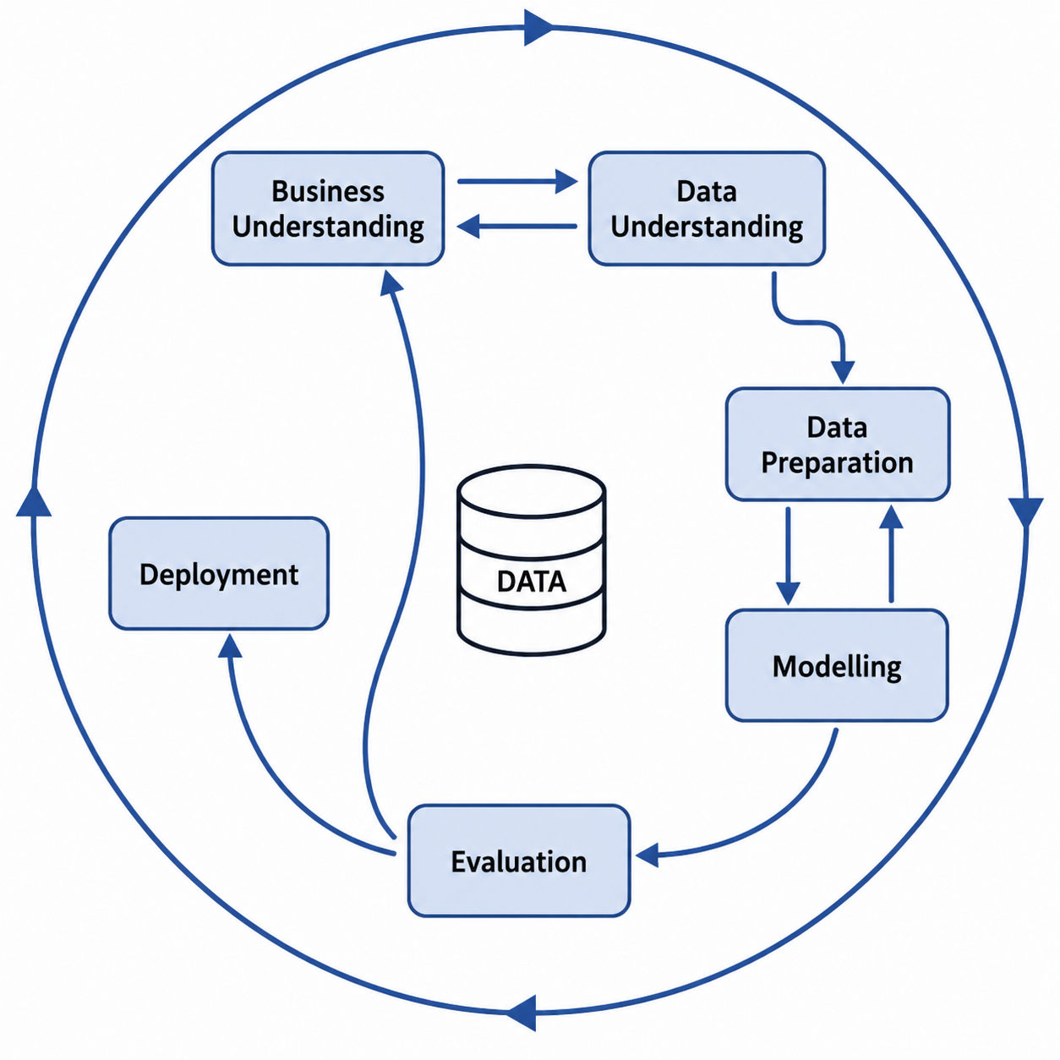
CRISP -DM FRAMEWORK
Business Understanding
Identify cybersecurity challenges faced by SMEs
Analyse the need for a Lightweight and affordable IDS Solution
Modelling
Train Logistic Regression, Decision Tree, and Random Forest models
Analyse their performance and computational efficiency
Data Understanding
Analyse the CICIDS 2017 Dataset structure and traffic classes
Perform EDA and correlation analysis
Evaluation
Evaluate models using accuracy, precision, recall, and macro F1-score
Select the most suitable model
Data Preparation
Apply label encoding and feature/target separation
Create dataset strategies for Modelling
Deployment
Propose a lightweight Streamlit dashboard prototype
Allow traffic upload and prediction visualisation

Slide 3
BUSINESS UNDERSTANDING
Problem | SMEs and small organisations often do not have dedicated cybersecurity teams, making suspicious traffic harder to detect in time (Forde, 2025).
Market Need | A lightweight IDS can support IT administrators and MSP technicians by reducing manual log analysis and improving visibility of possible attacks (Zamani ,2022).
Business Goal | Develop a practical machine learning prototype to classify network traffic as benign or attack traffic.
Success Criteria | Strong model performance, low runtime, interpretability, good attack coverage and a simple dashboard for prediction summaries.

Slide 4
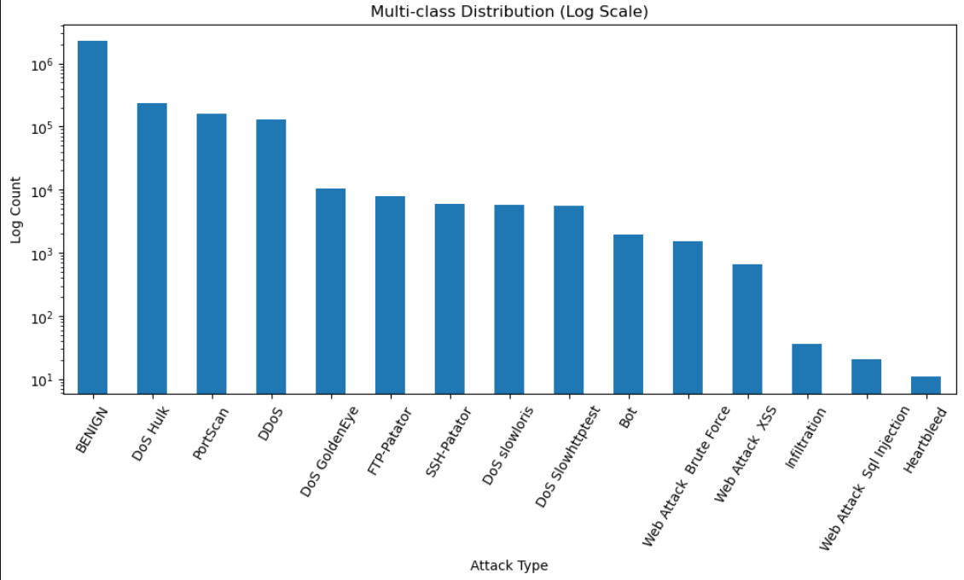
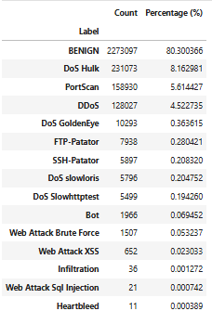
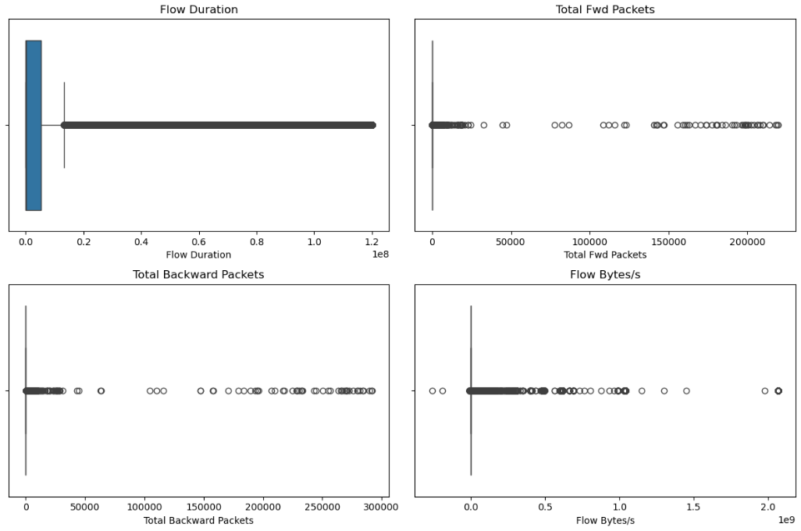
DATA UNDERSTANDING
CICIDS2017 Dataset
Controlled environment
8 CSV files with Network traffic and various attack types
Shape (2830743, 79)
2,867 missing values
15 attack classes
highly right-skewed and contain a large number of extreme outliers.

Slide 5
DATA PREPARATION
Goal:
Prepare the cleaned CICIDS2017 dataset for machine learning.
Main Steps:
• Defined Label as the target variable
• Separated features (X) and target (y)
• Encoded 15 traffic classes into numeric labels
• Removed highly correlated features using 0.90 threshold
• Reduced features from 70 to 39
• Applied 80/20 train/test split with stratification
• Created Full, Capped and Controlled dataset strategies
• Applied StandardScaler for Logistic Regression
Why This Matters:
This phase improved data quality, reduced complexity and prepared different dataset versions to compare model performance, runtime and attack coverage.
Cleaned Rows | 2,520,798
Original Features | 70
Removed Correlated Features | 31
Final Features | 39
Traffic Classes | 15
Train/Test Split | 80/20

Slide 6
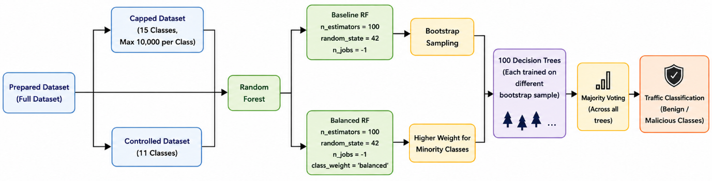
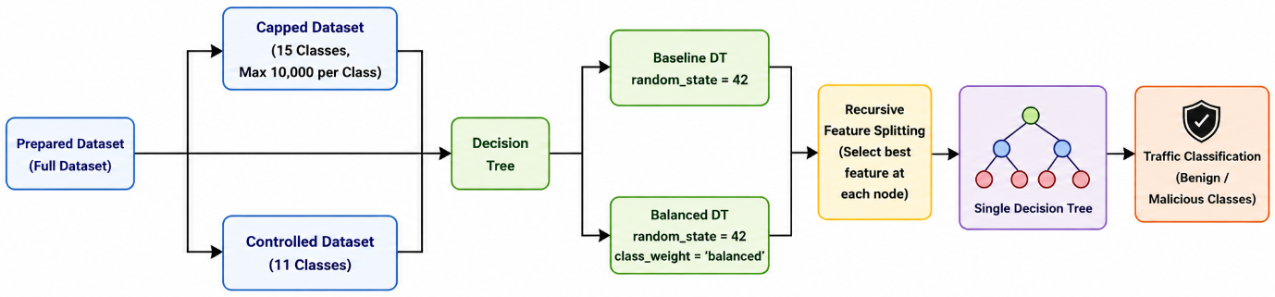
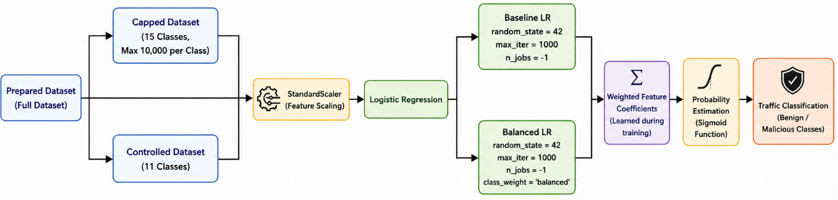
MODELLING
RF,DT and LR:
All 3 models were trained using the 3 datasets strategies, both with and without the balanced parameter.
LR used same datasets, but on a scaled version due to its sensitivity to feature magnitude (Nugroho, et al., 2018).
In total, 18 different model configurations were trained.
Further, 2 new tuning methods were used to DT model to achieve better performance, using:
Entropy: Which focus on creating purer child nodes, meaning traffic classes become more separated after each split (Dash, 2022), which improved classification of less frequent classes.
Log_loss: Also measure impurity, but from a probabilistic perspective, and encourages tree to make splits that improve confidence of class predictions, providing better estimates and class separation in multiclass problems Shi et al. (2015).

Slide 7
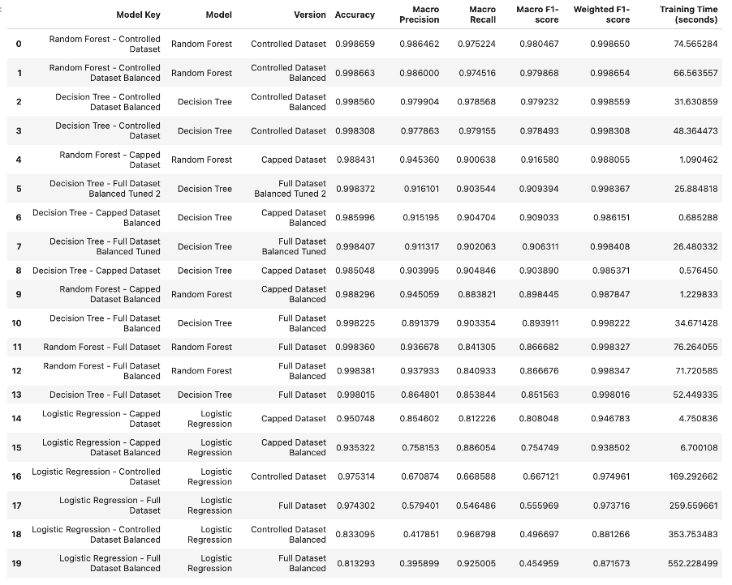
EVALUATION
Goal:
Compare all trained models and choose the best option for a lightweight IDS.
Metrics Used:
• Accuracy
• Precision
• Recall
• Macro F1-score
• Weighted F1-score
• Confusion matrix
• Training time
Main Findings:
• Accuracy alone was not enough because the dataset was highly imbalanced (Engelen, Rimmer and Joosen (2021)
• Logistic Regression was the weakest model, especially for minority classes
• Random Forest achieved strong results but had higher runtime
• Decision Tree gave the best balance between performance, runtime, interpretability and attack coverage
Final Model: Decision Tree – Full Dataset Balanced Tuned 2

Slide 8
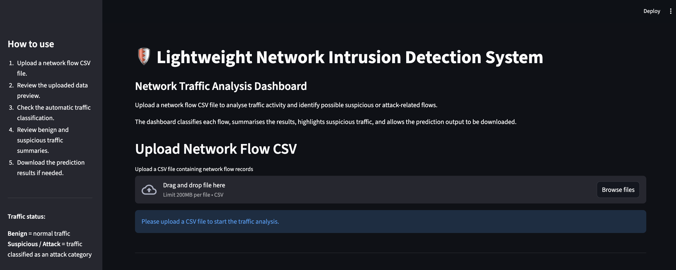
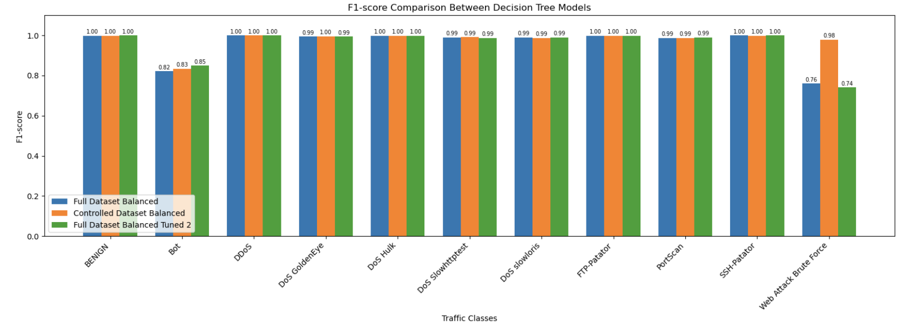
DEPLOYMENT & CONCLUSION
What was deployed?
What was Concluded?
CICIDS2017 successfully used for multiclass IDS classification
LR showed weakest performance
RF achieved strong results but higher computational cost
DT Full Dataset Balanced Tuned 2 provided the best balance between:
Performance
Runtime efficiency
Interpretability
Attack Coverage
Streamlit Prototype
Chosen model was saved, and loaded.
Prototype allows CSV upload for network traffic analysis
Generates traffic predictions and suspicious traffic summaries
Support prediction results download
Future Implementations
Integrate live network traffic
Retrain the model using newer cybersecurity datasets and attack patterns
Implement automated alerts for suspicious traffic detection
Compare lightweight machine learning models with deep learning approaches

Slide 9
REFERENCES
Dash, S. (2022) Decision Trees Explained - Entropy, Information Gain, Gini Index, CCP Pruning. Available at: Towards Data Science (Accessed: 26 May 2026).
Engelen, G., Rimmer, V. and Joosen, W. (2021) Troubleshooting an Intrusion Detection Dataset: The CICIDS2017 Case Study. Available at: DistriNet Research.
Forde, R. (2025) Reducing cyber security risks for Irish SMEs in 2025 and beyond. Available at: Cyber Ireland (Accessed: 9 May 2026).
Shi, Q., Reid, M., Caetano, T., van den Hengel, A. and Wang, Z. (2015) ‘A Hybrid Loss for Multiclass and Structured Prediction’, IEEE Transactions on Pattern Analysis and Machine Intelligence, 37(1), pp. 2–12. doi: https://doi.org/10.1109/TPAMI.2014.2306414.
Slidesgo (n.d.) Free presentation templates and themes. Available at: Slidesgo (Accessed: 29 May 2026).
Zamani, S.Z. (2022) ‘Small and Medium Enterprises (SMEs) facing an evolving technological era: a systematic literature review on the adoption of technologies in SMEs’, European Journal of Innovation Management, 25(6). doi: DOI.

